Slide 1


A Toolset for Dynamic
Assessment of Capabilities
By Christian Mundreanu
Mentors: Larry Ullom & Sam Brown

Slide 2

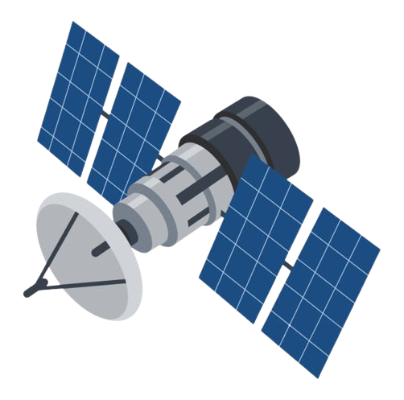
Background
Dynamic testing involves executing software and driving it with inputs or commands to observe behavior and detect issues
Mission software can be dynamically tested across multiple environments and fidelities, from isolated function tests to full-system emulation

Slide 3
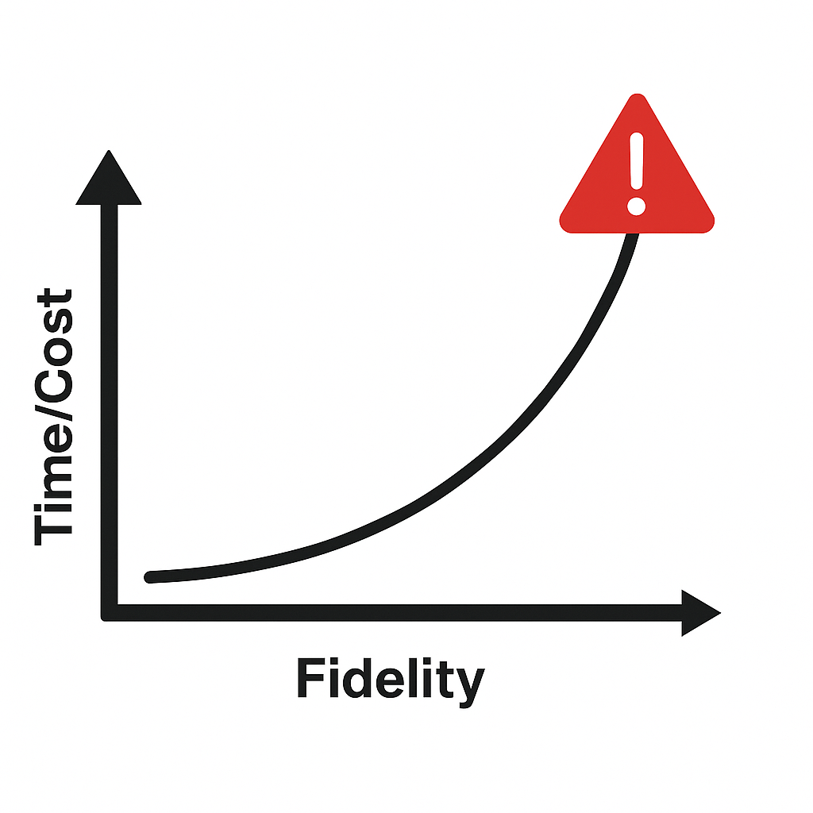
Motivation
Higher-fidelity environments better replicate mission conditions, but at a steep cost in time and resources.
Setup time, system requirements, and testing complexity increase exponentially with fidelity
Some issues can be found in lower-fidelity environments, rather than jumping straight to full-system testing

Slide 4
Project Outline
1
Set up testing environments
2
Run tests across these environments
3
Analyze environment capabilities and tradeoffs

Slide 5
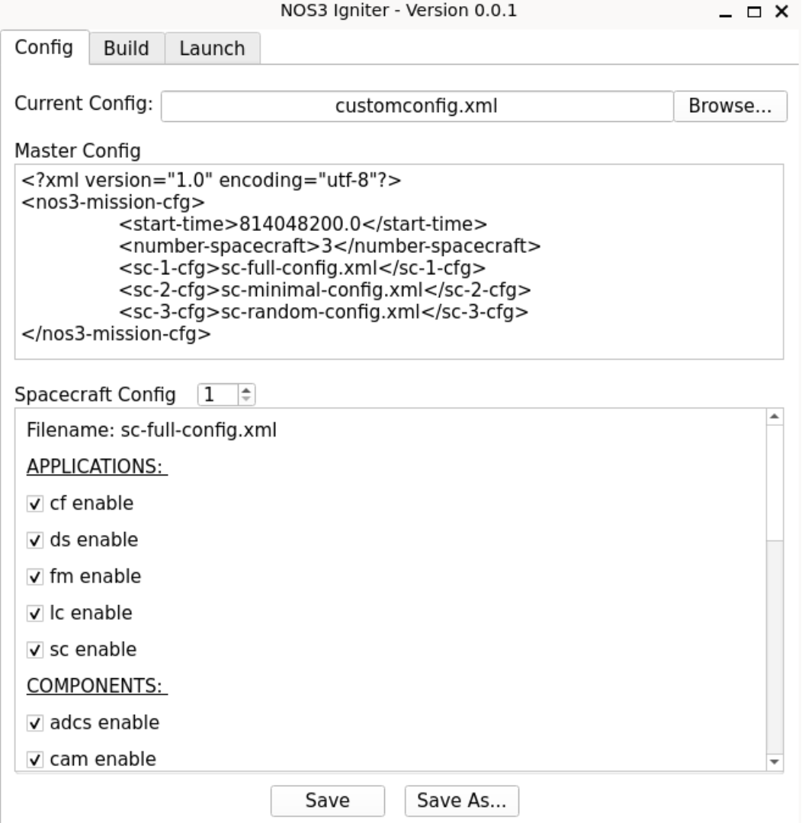
NOS³:
Foundation for Testing Environments
NOS³ Framework:
Open-source codebase for the testing and development of small satellite missions
Full STF-1 CubeSat flight software (test target: Electrical Power System - EPS - component)
Suite of simulation tools + full-system sim
Configurability:
Flexible toolchain allowed for inclusion/removal of simulation assets (e.g. components, orbital simulator - 42, GSW)
Igniter Configuration UI

Slide 6

Testing Environments

Slide 7
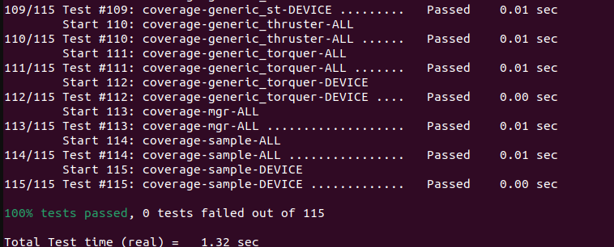
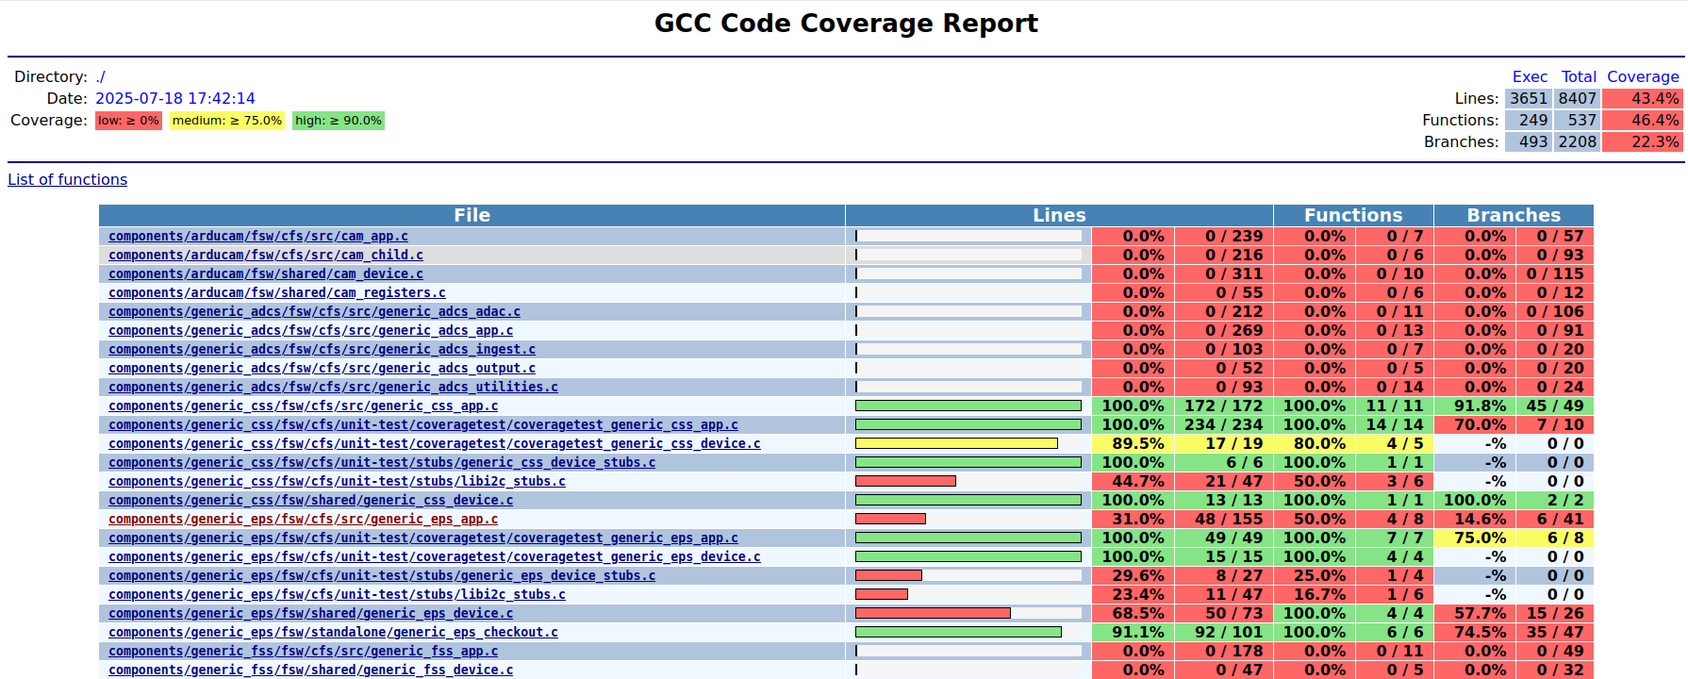
Environment 1: Unit-Level Testing
Executes a minimal portion of FSW
All external dependencies are mocked/stubbed out
Open-loop only; limited to static responses, no time-based, hardware behavior, or feedback driven interactions
Unit Test Terminal Output
Code Coverage Report
Code Coverage Report

Slide 8
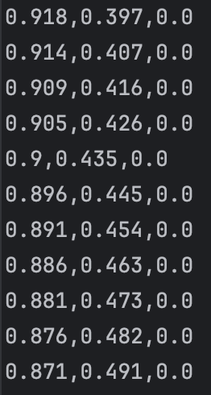
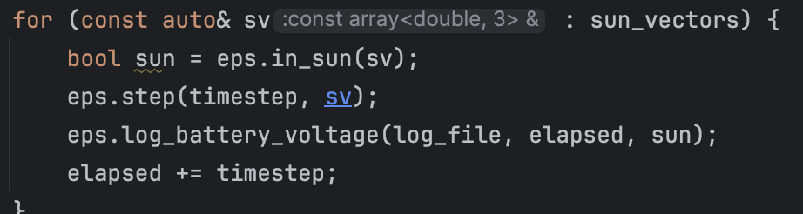
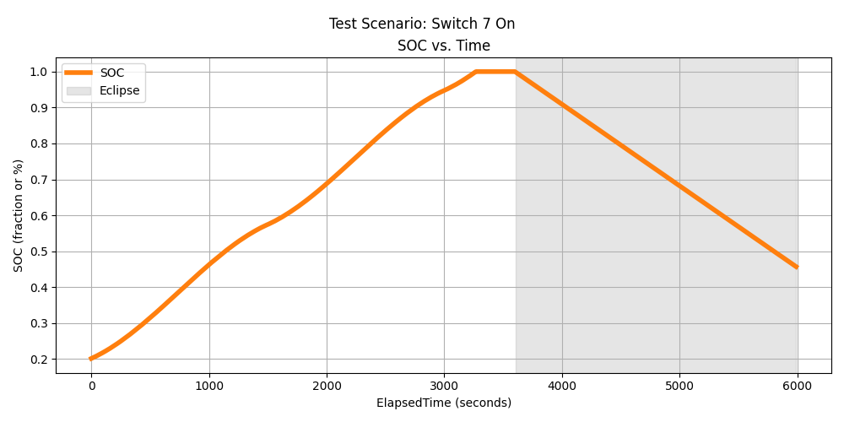
Environment 2: Component Model Wrapper
Test Process: (Static Input → Model → Output)
Isolates a component’s simulation logic in a standalone development environment — extracted from NOS³
Supports closed-loop testing; simulates how the component behaves over time in response to feedback — helping uncover issues that may not be evident in unit tests alone
Uses predefined, static inputs
Solar Vector Input Snippet
Code Wrapper Snippet
Note: My implementation only included the sim model, not yet driven by FSW. Without FSW, it's primarily useful for standalone modeling and behavior observation. Integrating FSW would enable full bug detection and realistic closed-loop testing.
Graph of Results (from output CSV)

Slide 9
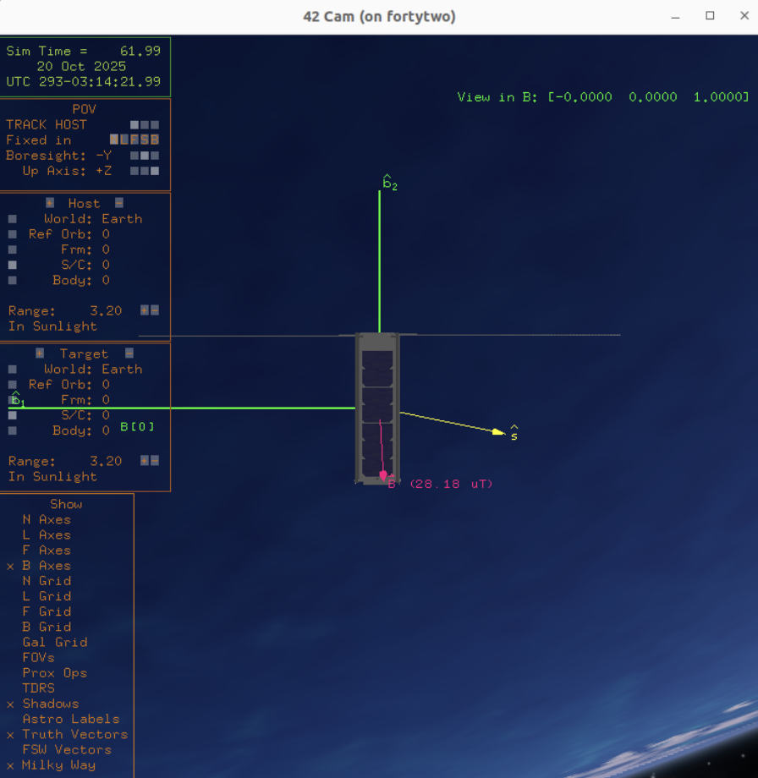
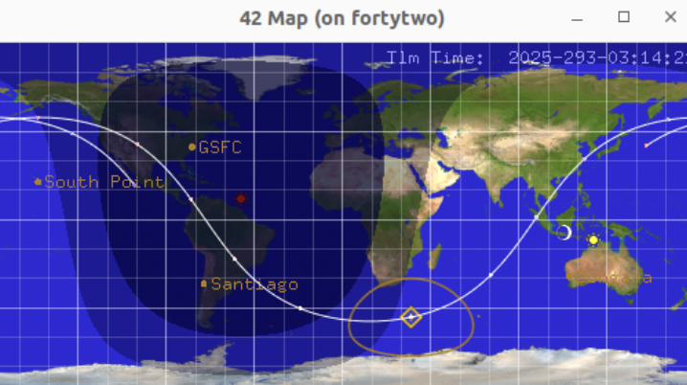
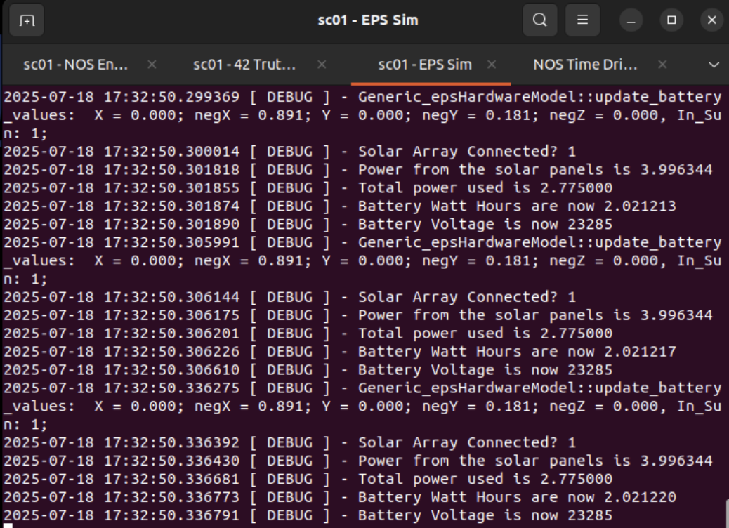
Environment 3: Component Wrapper with Environmental Dynamics
Runs a component’s FSW while linked to a simulated model
Uses 42 in parallel to provide dynamic, time-based environmental inputs and conditions
Still isolated to a single component
42 Map
42 Cam
Note: My setup used NOS³ to configure the environment, but similar results can be achieved by extending Environment 2 to include 42 support
EPS Simulator Terminal

Slide 10
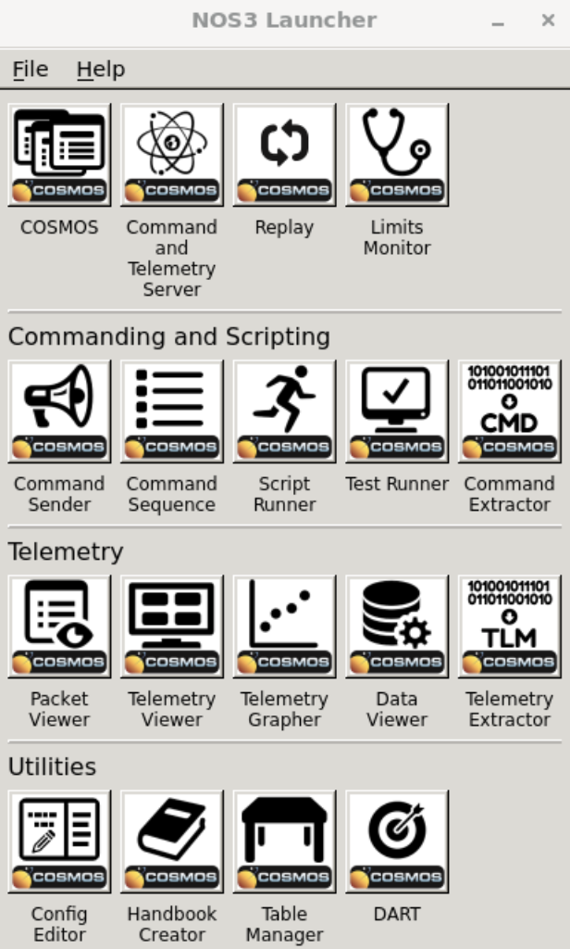
Environment 4: Full System Simulation
Executes complete FSW stack with all component models, middleware, ground tools, and an orbital simulator
Enables full integration and end-to-end system testing, closely mirroring actual flight
Operates within a full simulation infrastructure, no longer driven by standalone code execution
Note: Highest fidelity obtainable in my project; the next highest would be emulation, which aims to perfectly replicate the mission hardware in a digital form
NOS3 Launcher

Slide 11
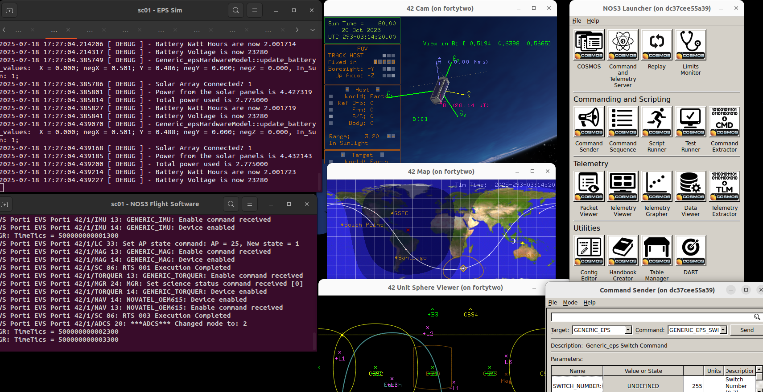

Slide 12
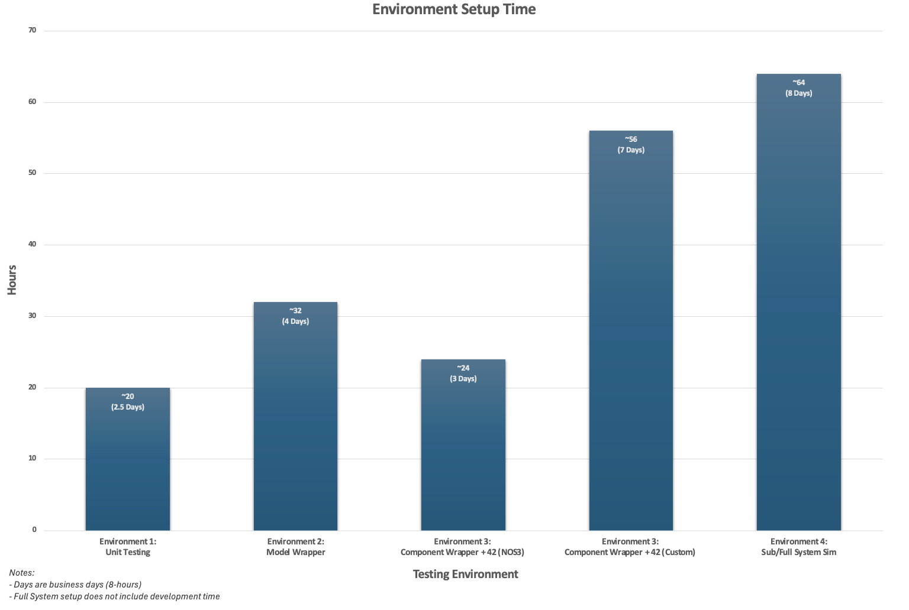


Slide 13

Off-Nominal Testing

Slide 14
Test Scenario Examples
Test | Goal
1. Mismatched Packet | Test EPS response to an improperly formatted command packet
2. Unintentional Switch Activation | Simulate unintended power drain; evaluate each environment’s ability to reveal logic flaws or abnormal energy usage
3. Broken Solar Panel | Evaluate EPS response and resilience with a panel offline
4. Rapid Tumbling | Assess EPS performance under unstable satellite orientation

Slide 15
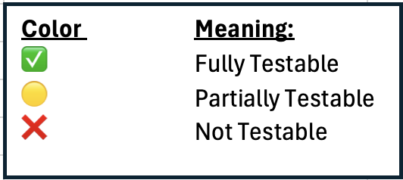
Test | Env 1 (Unit) | Env 2 (Model) | Env 3 (Model+42+FSW) | Env 4 (Full System)
Mismatched Packet | ✅ | ❌ | ❌ | ❌
Unintentional Switch Activation | 🟡 | ✅ | ✅ | ✅
Broken Panel | ❌ | 🟡 | ✅ | ✅
Rapid Tumbling | ❌ | ❌ | ✅ | ✅

Slide 16
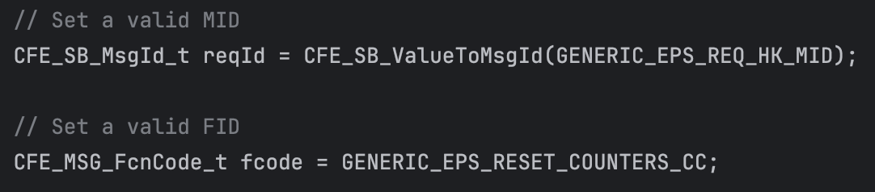
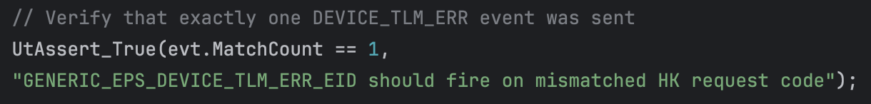
Environment 1 Findings:
Pros:
Best for catching logic/command bugs (e.g., mismatched packets, switch errors)
Rapid test setup, creation, and execution
Cons:
Lacked ability to simulate physical responses (e.g. broken panel, tumbling, power drain)
Issues not directly evident in logic may go unnoticed without behavioral feedback
Custom Packet Creation
Assert EPS fires error event

Slide 17
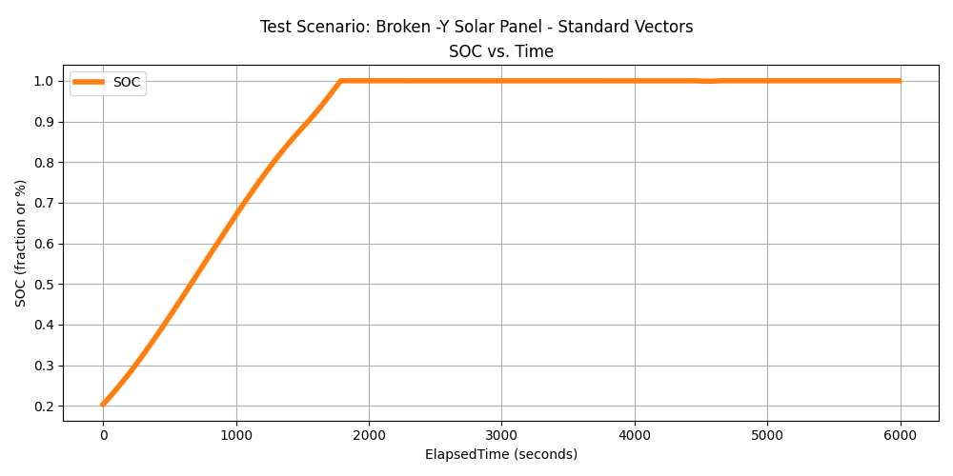
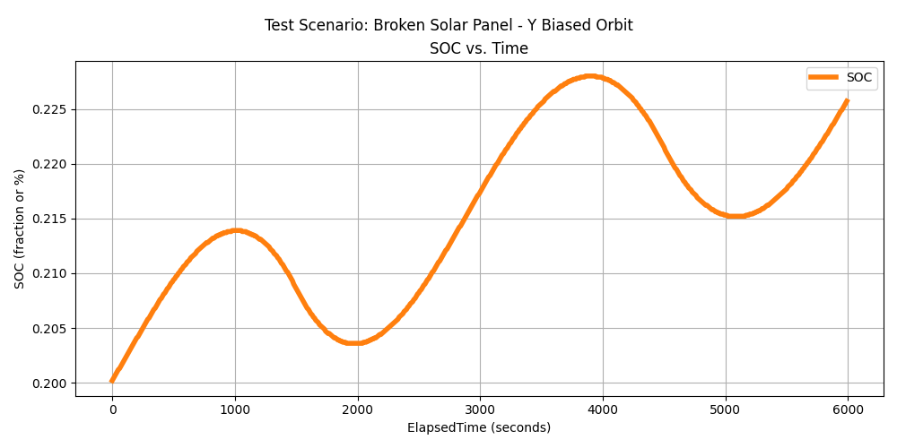
Environment 2 Findings:
Pros:
Rapidly tested EPS behavior and resiliency under fault conditions (e.g., stuck switch, broken panel)
Enabled long-duration behavior modeling with fast runtime
Cons:
No FSW integration limited root cause tracing
Static inputs (e.g., fixed sun vectors) restricted realism in dynamic scenarios like a broken panel and tumbling
Env 2: X-Biased Orbit
Env 2: -Y-Biased Orbit

Slide 18
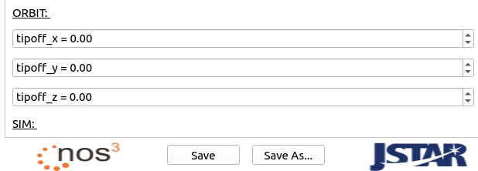
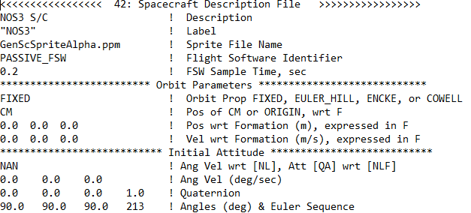
Environment 3 Findings:
Pros:
Detection of both software bugs and resulting system behavior
Supported various dynamic scenarios (e.g., tumbling, orientation changes)
Cons:
Required configuring 42 simulator, increasing setup complexity and time
Testing was slower due to reliance on NOS³ but could be bypassed in an isolated environment
Orbit Tipoff Config (passed to 42)
42 Config Snippet

Slide 19
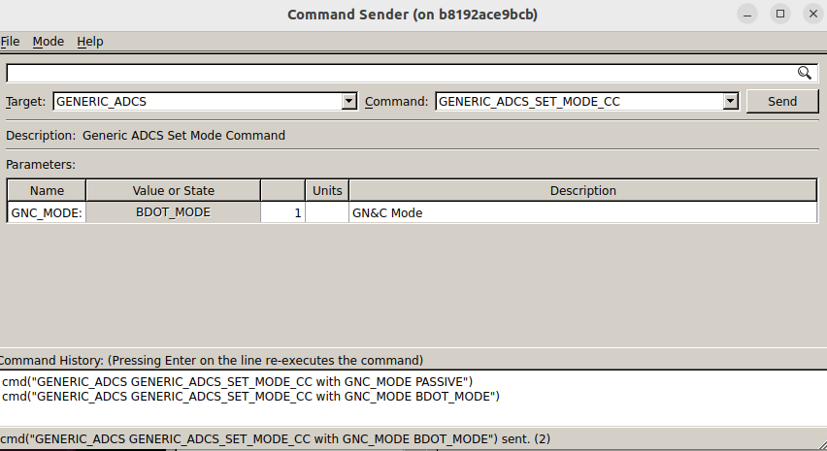
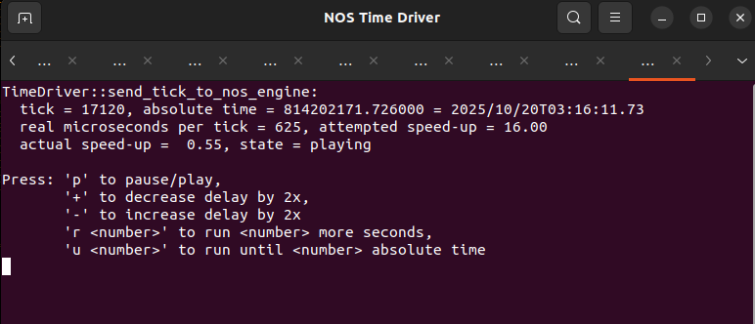
Environment 4 Findings:
Pros:
Supported end-to-end bug detection
Enabled testing of system-level responses (e.g., reorientation, stabilization during tumbling)
Cons:
Slow setup and execution; some simulations ran slower than real-time
Harder to isolate issues, complex interactions obscure the exact fault location
Env 4: Stabilizing Command
NOS Time Driver

Slide 20
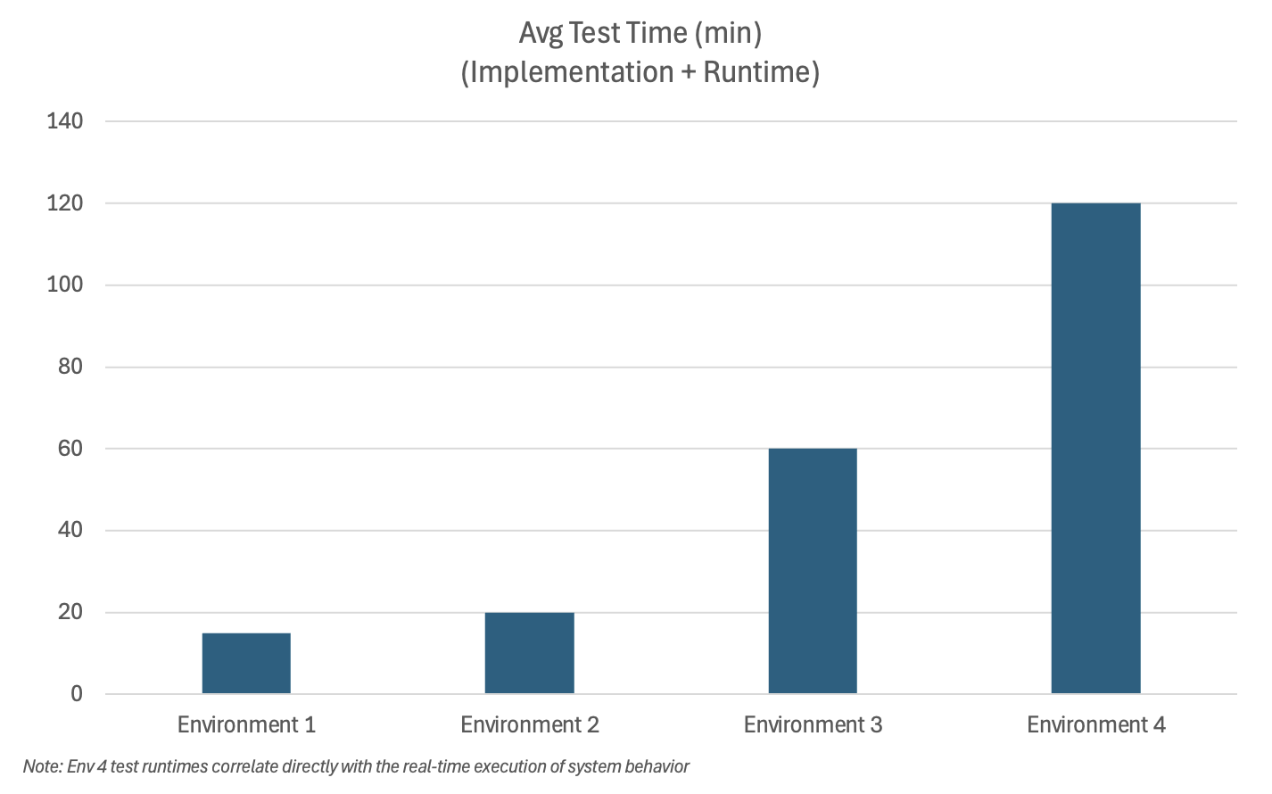

Slide 21
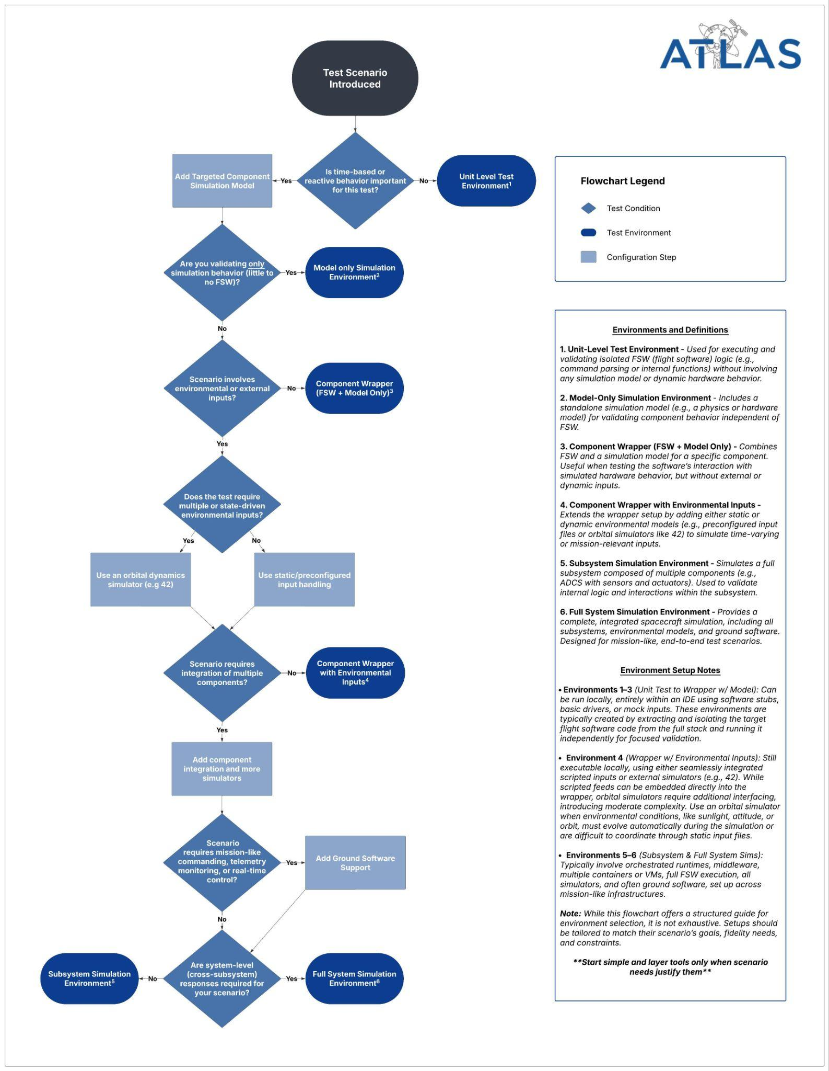
ATLAS:
Advisory Tool for Logical Analysis and Simulation
Decision Guide to construct and select the minimum viable testing environment for a given test scenario
Streamlines test planning by helping engineers avoid unnecessary high-fidelity setups
Framework focuses on core environment traits, not specific toolchains — allowing flexibility for different developer setups and tailored use cases

Slide 22
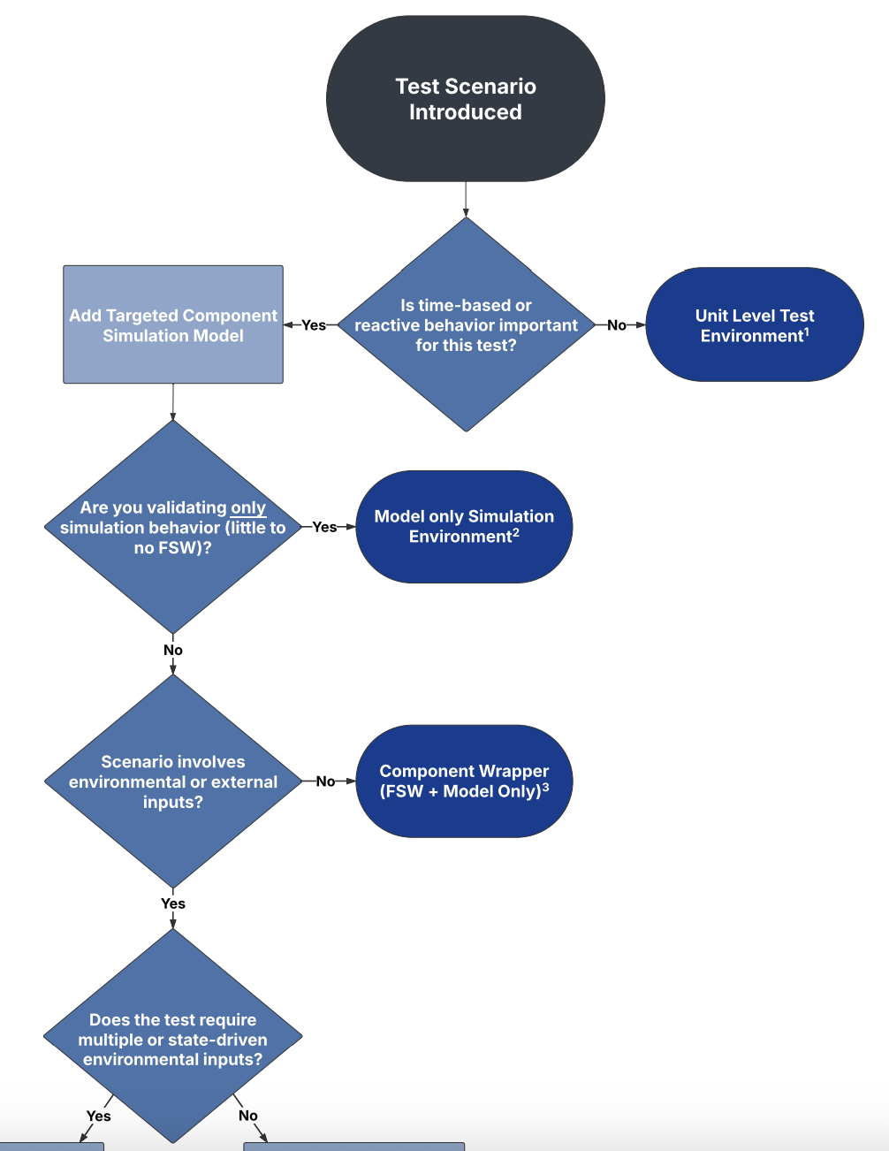
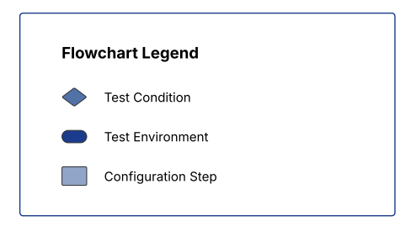
Top Half

Slide 23
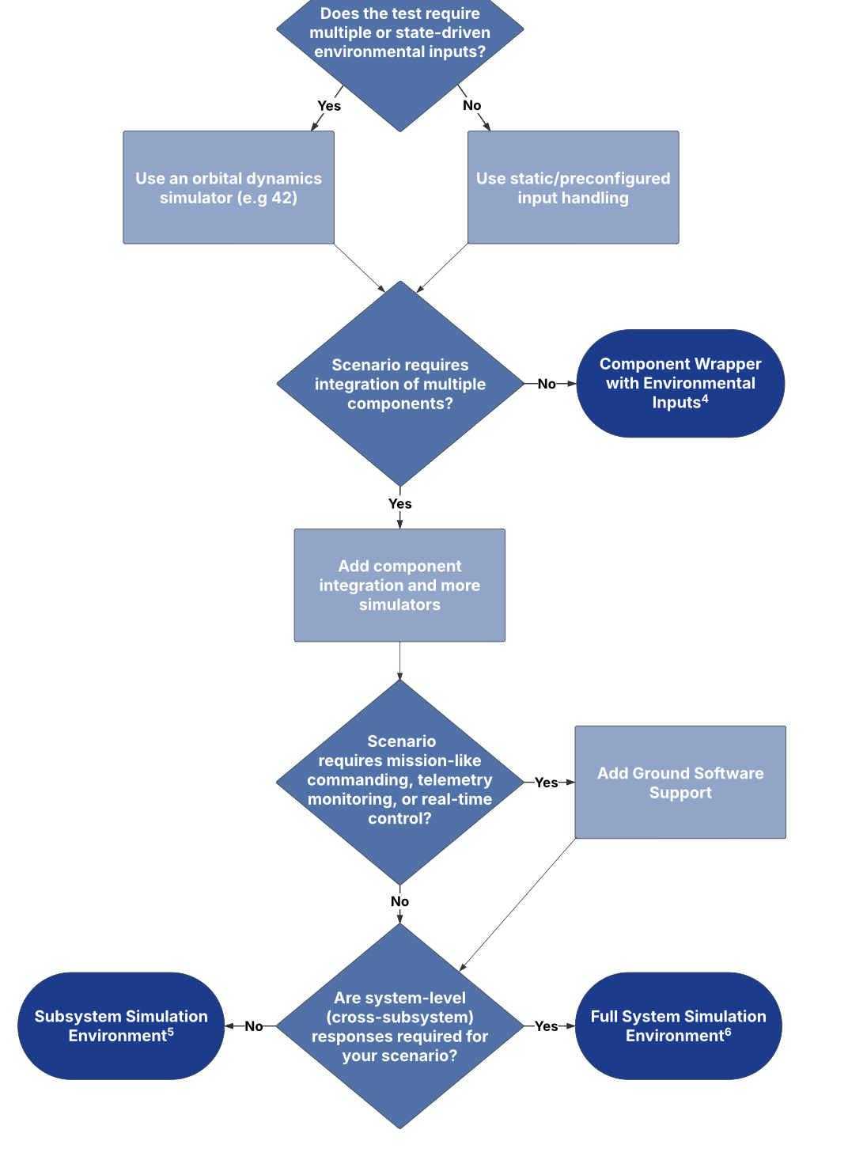
Bottom Half

Slide 24
Main Takeaways:
Lower-fidelity setups handle many component oriented tests effectively
Especially when combining FSW, simulation models, and orbital inputs
Standalone environments streamline testing
Rapid and intuitive test creation without full system overhead
Isolation improves root cause analysis
With fewer moving parts, bugs can be traced more directly to their source
Full-system simulations are essential - when needed
Best used when validating full integration or system-wide interactions — but not always needed for every test.
Modular environments are crucial
The ability to scale complexity up or down makes dynamic analysis more efficient and adaptable

Slide 25
Personal Takeaways:
Recognized the engineering and development behind testing itself
Witnessed the real tradeoffs of engineering

Slide 26
Acknowledgements:
Larry Ullom
Sam Brown
Scott Zemerick
John Lucas
Zachary Lynch
JSTAR
Jess White
Jeff Northey
NASA IV&V team
Thank you all for your invaluable guidance and support throughout this project!

Slide 27

Questions?

Slide 28
Supplemental Information

Slide 29
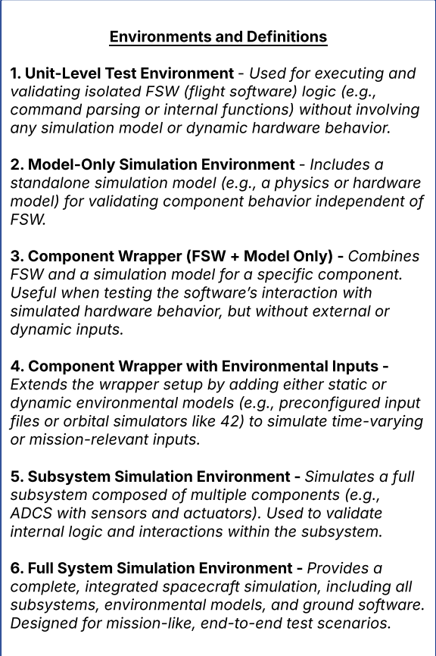
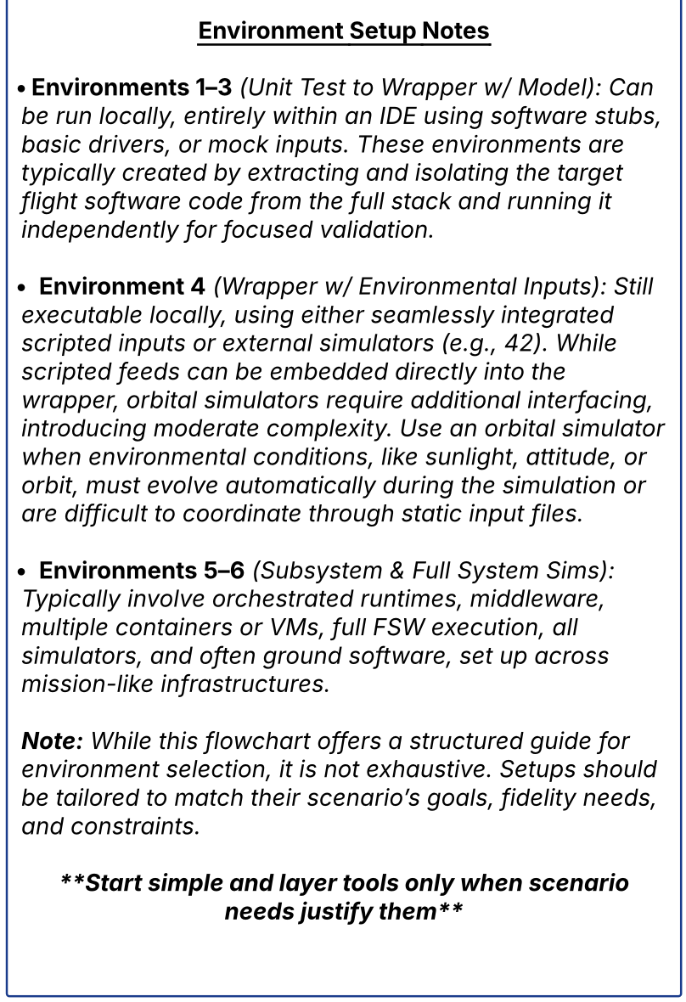

Slide 30
